Slide 1

Android Based Wi-fi Controlled robot for Store Management
Ronak Surana 20uec105
Ashish Sharma 20ume013
Under Guidance of:
Dr. Atul Mishra
Special Mention:
Mr. Udayveer Sharma
Presented on Date: 20-11-23

Slide 2
Agenda
Introduction
Literature Review
Methodology
Results
Discussion
Conclusion
References

Slide 3
Introduction
Captures Shelf Photo
Count Products Placed on shelf
OOS Situation
Robot
Solution
Android App
Planogram
RPI board ,RPI Camera, Robot Movement,Image Recognition
Motive
More Labour
More Wages
Loss of Profit,
Customer Dissatisfaction
Large Shopping Stores
Non-Availability
Planogram

Slide 4
Methodology
Robot Development
Android APP
Raspberry Pi
Design Selection
Code Writing
Android Studio
RPI Camera
Motor Driver
No of wheels
Image Processing SURF
DC Motor Running RPI
and App
Auto Run RPI
Image Processing
DC Motor
3 wheels

Slide 5
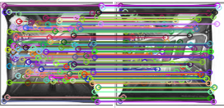
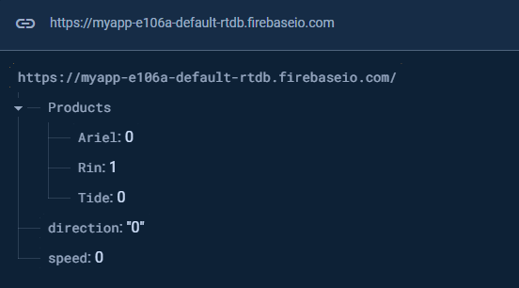
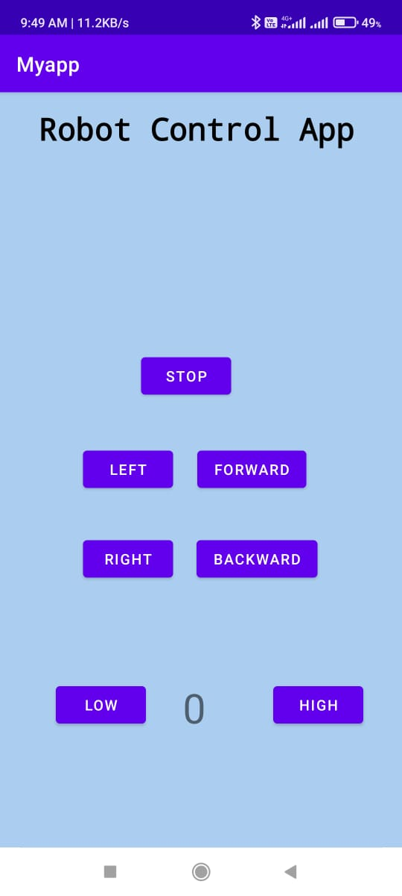
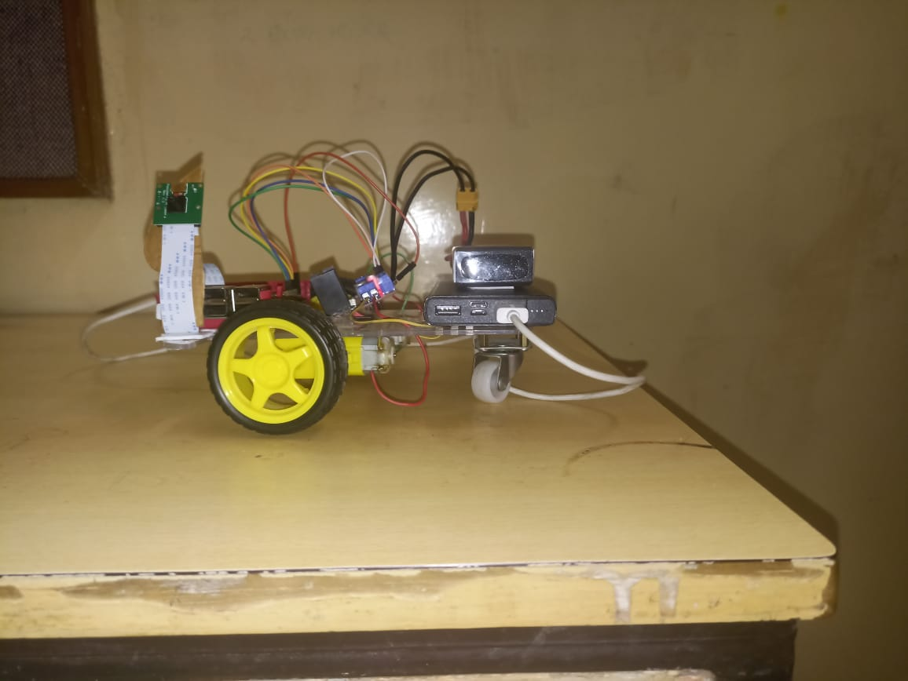
Results
Android App
Image Feature Matching
Database
Robot Model

Slide 6
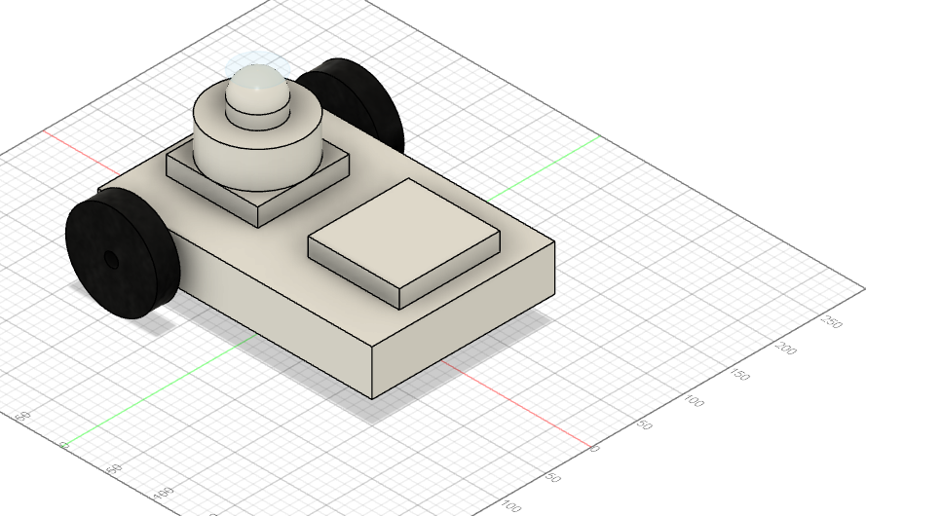
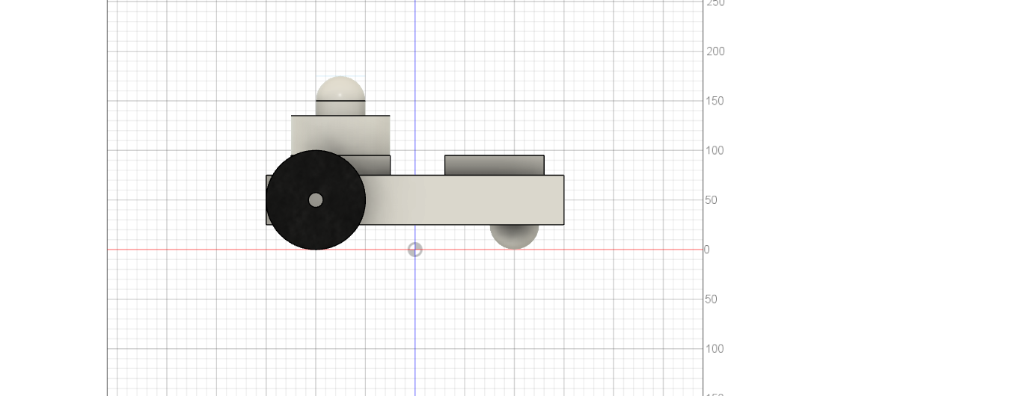
Discussion
Android App
->Direction to Robot
->Data in firebase Update
->Speed field
->Direction field-0=stop,1=left,2=right,
3=forward,4=backward
Motor Running
->Collects data from firebase
->speed pulse width modulation
->direction
->In1=High,In2=Low->forward
->In1=Low,In2=High->backward
->In1=Low,In2=Low->Stop
Image Processing
->RPI camera captures image
->Compares target Image (Captured) with existing images in database
->Match Found Update in DB

Slide 7
Conclusion and Future Work
Conclusion
Future Work
Provided Robot Based Solution
Product Count ,OOS ,Planogram
Design Robot
Image->Algorithms
Improve Accuracy
Count Unpacked Products
Auto place and Pick

Slide 8
References
[1] R. Moorthy, S. Behera, and S. Verma, “On-shelf availability in retailing,” vol. 115, pp. 47–51, 04 2015. [2] W. C. Guy Campion, “Handbook-robotics-ch-17,” [3] Raspberry Pi.[Online].https://www.raspberrypi.com/documentation/. [4] Open CV.[Online].https://docs.opencv.org/4.x/d6/d00/tutorial py root.html. [5] B. Forgan, “What robots can do for retail.” [6] B. Morgan, “The 3 best in-store robots and why they work.” [7] K. Matthews, “5 robots now in grocery stores show the future of retail.” [8] R. Moorthy, S. Behera, S. Verma, S. Bhargave, and P. Ramanathan, “Applying image processing for detecting on-shelf availability and product positioning in retail stores,” pp. 451–457, 08 2015. [9] T. Zimmerman, “System and method for performing inventory using a mobile in- ventory robot,” Mar. 27 2008,uS Patent App. 11/534,162. [Online]. Available: https://www.google.com/patents/US20080077511. [10] S. B. Gokturk and A. Rafii, “Occupancy detection and measurement system and method,” Oct. 2 2003,uS Patent App. 10/678,998. [11] Y. Hofman and M. Rotenberg, “System and method for identifying retail products and determining retail product arrangements,” June 20 2012, uS Patent App. 13/528,189. [12] Wikipedia, “Differential wheeled robot.

Slide 9
Thank you

